Slide 1
HCI - Virtual Reality (VR) and
Augmented Reality (AR)​
An Exploration of Interfaces, Technologies, and Applications

Slide 2
Content
1
Background
A
Introduction of the context and foundation concepts
2
Significance
B
Discussing the impact and influence of the subject in real life.
3
Technologies
C
AR/VR technologies in eLearning: Opportunities and Challenges
4
Innovations
D
Review of current methods and creative advancements.
5
Future
E
Unresolved issues and possibilities for future research.

Slide 3
Background:
Introduction of the context and foundation concepts
~Priyanshu Nareda

Slide 4
Exploring the World of HCI with Virtual and Augmented Reality!
Welcome to our exploration of Human-Computer Interaction (HCI), Virtual Reality (VR), and Augmented Reality (AR).
Today, we’ll dive into the fascinating history, recent advancements, and future possibilities of these
transformative technologies.
Let’s embark on this journey to understand how these innovations are shaping our interaction with
technology and our world.

Slide 5












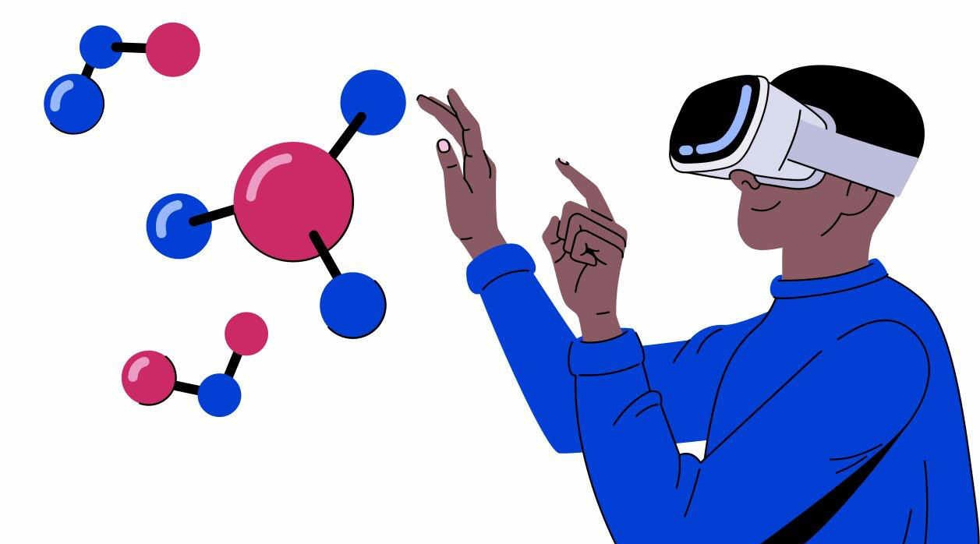
What is Human-Computer Interaction (HCI)?
HCI Definition:The study of human-computer interaction and designing technologies for innovative user engagement.
Importance of HCI:Ensures technology is user-friendly and accessible, shaping everything from websites to virtual environments.
HCI Evolution:Progressed from text-based interfaces to modern graphical and immersive ones.

Slide 6
The Evolution of HCI
Early Beginnings:
HCI began with command-line interfaces and text-based systems.
Users manually inputted commands, leading to text-heavy interactions.
Introduction of GUIs:
Graphical User Interfaces (GUIs) introduced visual elements like icons and windows.
These advancements made user interactions more intuitive and accessible.
Modern Advancements:
Today, HCI focuses on enhancing user experience through natural interfaces.
Innovations include voice recognition, gesture controls, and more intuitive interaction methods.

Slide 7
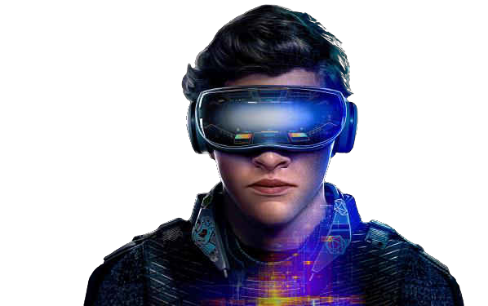
What is VR?
Definition of VR: A simulated experience that can be similar to or completely different from the real world, typically achieved using headsets that provide immersive environments.
Key Components
Headsets
Controllers
Immersion and Presence: VR aims to create a sense of immersion and presence, making users feel as if they are truly "inside" the virtual environment.

Slide 8
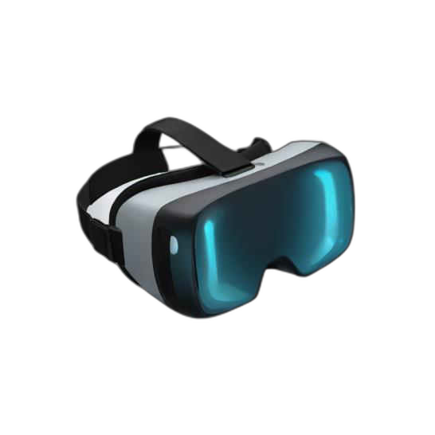
The Evolution of VR Technology
Early Origins:
VR's concept dates back to the 1960s with initial simulation experiments.
Advancements in the 1990s:
The 1990s marked the rise of advanced VR systems featuring headsets and motion tracking.
Recent Developments:
Modern VR includes lightweight headsets, enhanced graphics, and more interactive experiences.
Increased Accessibility and Immersion:
These advancements have made VR more accessible and immersive, broadening its applications across various fields.

Slide 9

What is AR?
Definition of AR: A technology that overlays digital information onto the real world, enhancing what we see, hear, and feel in our real environment.
AR vs. VR: Unlike VR, which creates a completely immersive environment, AR enhances the real world with digital information, allowing for interaction with both real and virtual objects.
Key Components:
AR Glasses
Mobile Devices
9

Slide 10
The Evolution of AR Technology
Early Foundations:
AR originated in the 1960s with experiments in blending digital information with the real world.
1990s Development:
AR advanced with head-mounted displays and early applications in industry and military.
21st Century Advancements:
The 2000s brought smartphone apps and wearable AR devices.
Modern Innovations:
Recent improvements in sensors, processing, and interfaces enable more seamless AR experiences.
10

Slide 11
Significance and Impact of VR and AR in HCI:
Exploring the Transformative Effects of Immersive
Technologies
~Utkarsh Lohiya

Slide 12
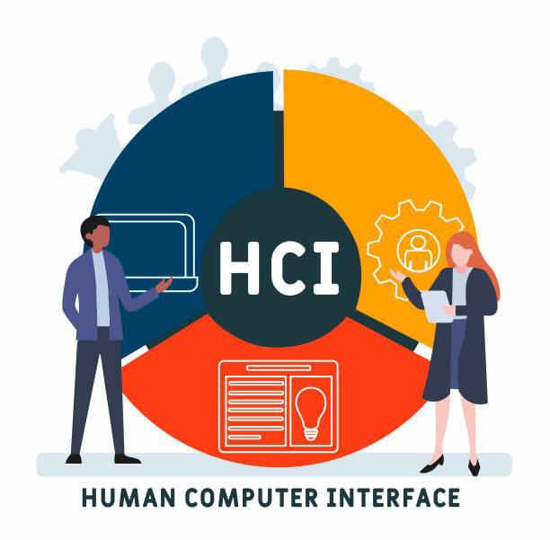
Why HCI Matters
HCI is crucial because it impacts how we interact with technology.
Imagine trying to use a complex system versus a user-friendly interface—good HCI turns frustration into ease and satisfaction.
Effective HCI design leads to improved productivity and user satisfaction by ensuring technology meets users' needs and preferences.

Slide 13
Overview of VR and AR in HCI
VR and AR are reshaping the landscape of Human-Computer Interaction (HCI) by creating more engaging
and intuitive user experiences.
Immersive technologies like VR and AR have evolved significantly from their inception.
From early prototypes to modern-day applications, they have a very big historical perspective.

Slide 14
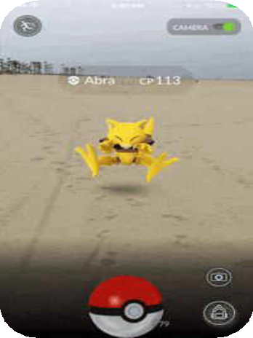
How VR and AR are Revolutionizing Entertainment
VR and AR are changing the entertainment landscape by offering deeply immersive experiences in games, movies, and interactive content.
Users can step into virtual worlds, interact with characters.
They enhance gaming, training simulations, virtual tourism, virtual
concerts, and immersive storytelling etc.

Slide 15

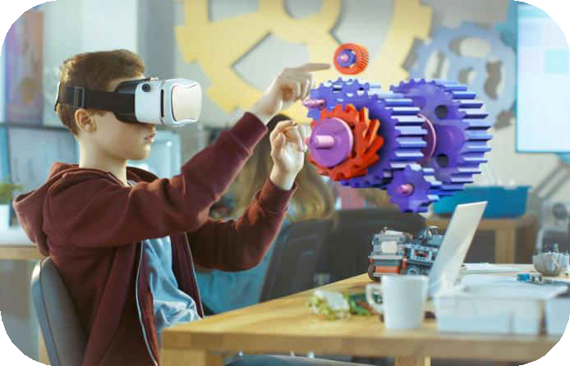
Enhancing Learning with AR and VR
AR and VR transforms education by making learning more interactive and engaging.
AR applications can overlay digital content on physical textbooks, bringing subjects to life with 3D models and
animations.
Virtual field trips and interactive simulations provide students with new ways to explore and understand complex concepts.

Slide 16
Transforming Healthcare with VR and AR
VR is used for medical training and simulations, allowing professionals to practice procedures in a safe
environment.
AR aids surgeons by overlaying critical information during operations, improving precision.
Both technologies are also used in patient rehabilitation, pain management etc.

Slide 17
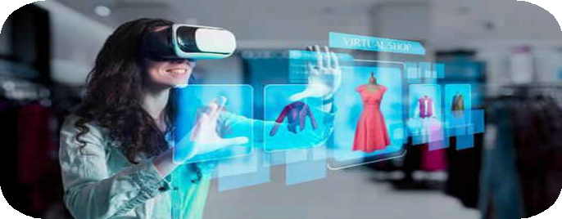
Everyday Applications of VR and AR
VR offers virtual tours and immersive experiences for travel and
leisure.
AR enhances daily activities with applications like navigation aids, interactive shopping experiences, and real-time information overlays.
These technologies are becoming part of our routine, making everyday tasks more efficient and enjoyable.

Slide 18
Everyday Applications of VR and AR
Social Media and AR: New Frontiers
AR is being integrated into social media platforms to enhance user engagement with interactive content.
Here we explore various
applications of AR in social media and its impact on user interaction.
VR and AR in cultural heritage and tourism
VR and AR provide new ways to explore cultural heritage sites and enhance tourism experiences.
Virtual tours and augmented reality guides make cultural education more accessible and engaging.
Application in architecture
VR and AR are used extensively in architecture for virtual tours, design visualization, and interactive property walkthroughs.
we explore how these
technologies benefit architects and real estate professionals.

Slide 19
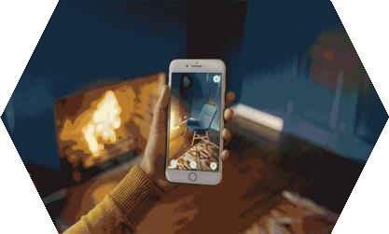
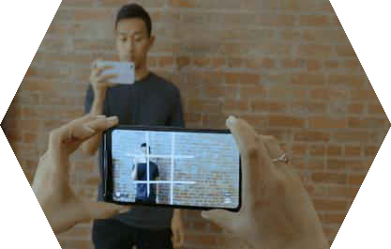

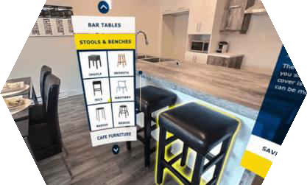




Everyday application of VR and AR
Case Study: AR in Retail – The IKEA App
This slide examines how IKEA uses AR to enhance the shopping
experience, allowing customers to visualize products in their homes before purchasing.

Slide 20
AR/VR Technologies in eLearning:
Opportunities and Challenges
Exploring the Impact of Immersive Technologies on Learning
~Shubham Kumar
20

Slide 21
Enhancing Engagement and Retention
AR and VR can provide an immersive and interactive learning experience that is more engaging than traditional methods.
Research has shown that immersive technologies can improve information retention and recall.
A study by the University of Maryland found that participants who learned using VR remembered
information better than those who learned through traditional methods.

Slide 22


Providing Realistic Simulations
AR and VR can be used to create realistic simulations of real-life scenarios.
This can be particularly useful for training in high-risk industries, such as healthcare or aviation.
A study by the University of Georgia found that medical students who used a VR simulator for a surgery procedure performed significantly better than those who used traditional methods.

Slide 23
Negative Aspects of AR/VR
Cost: High initial investment required for developing AR/VR content.
Technical Issues: Complex nature of AR/VR technologies demands advanced technical expertise for development and maintenance.
Health and Safety Concerns: Extended exposure to AR/VR environments can result in health issues like motion sickness, headaches, and eye strain.

Slide 24
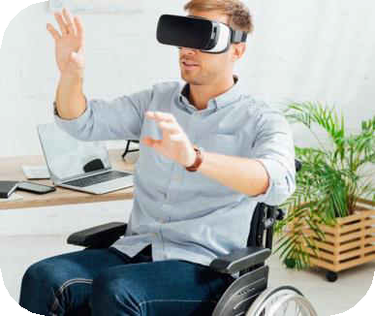
HCI Usability Challenges
Usability challenges in HCI include designing interfaces that are accessible to people with diverse needs and abilities.
Ensuring that technology is intuitive and user-friendly across different devices and platforms is also a challenge.
Usability testing and user feedback are crucial for identifying and addressing these issues, creating interfaces that work well for everyone.

Slide 25
Addressing VR Comfort Issues
VR comfort issues: such as motion sickness and headset discomfort are common challenges.
Advances in headset design, motion tracking, and user
experience are helping to reduce these issues.
Comfort improvements include lighter headsets and adjustable fit to enhance the VR experience.
Motion sickness occurs when there’s a disconnect between what the
user sees and their physical movements.

Slide 26
Data Privacy Concerns in AR
AR applications often collect extensive data about users and their surroundings, raising privacy concerns.
Ensuring that this data is securely stored and used responsibly is vital.
Clear privacy policies, user consent, and transparent data practices help address these concerns and build trust in AR technologies.

Slide 27
The Digital Divide and Access to Technology
Access to HCI, VR, and AR technologies is not equally distributed, leading to a digital divide.
Ensuring that these technologies are affordable and accessible to diverse populations is crucial.
Efforts to bridge this gap include developing low-cost hardware, creating inclusive design practices, and providing educational resources to underserved communities.

Slide 28
Innovations:
Review of current methods and creative advancements.
~Sahil Kumar

Slide 29

Advances in HCI Technology
Natural User Interfaces (NUI): Intuitive interfaces like voice, gesture.
AI-Powered Personalization: Adapts systems to user preferences.
Immersive AR/VR Experiences: Blend physical and digital worlds.
Emotion Recognition: Adapt in real-time, making interfaces more empathetic and responsive.

Slide 30

Innovations in VR Technology
Ultra-Realistic Visuals: Enhancing immersion and making VR experiences more lifelike.
Inside-Out Tracking: Cameras and sensors to monitor the user's movements within a virtual environment.
Eye Tracking Technology: Gaze-based enhances user experience by making interactions more responsive and reducing the computational load on the system.
30

Slide 31
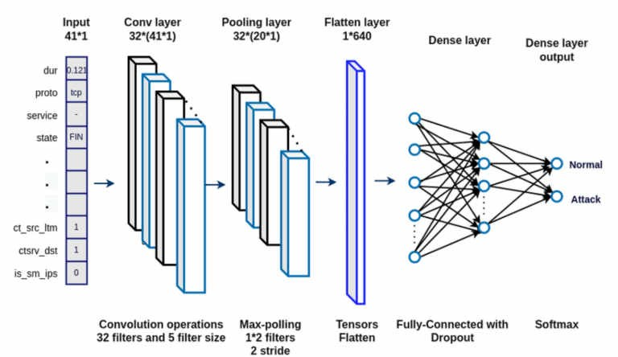
Technologies & How they work in VR.
Computer Vision:
Convolutional Neural Networks (CNNs): Multiple perceptron layers are trained for better vision perception.
Haptic Feedback
Reinforcement Learning (RL): Adapts the intensity and nature of haptic feedback with the help of latest technologies like Transformer (Transfer Learning) based on multi-head attention techniques.

Slide 32
Contd…
Advanced Robotic Locomotion in VR
Reinforcement Learning for Locomotion: Robots, such as bipedal systems or robotic avatars, use reinforcement learning to learn how to walk or move dynamically. Deep Reinforcement Learning (DRL) techniques like Proximal Policy Optimization (PPO) help these systems learn complex locomotion patterns based on trial-and-error.

Slide 33
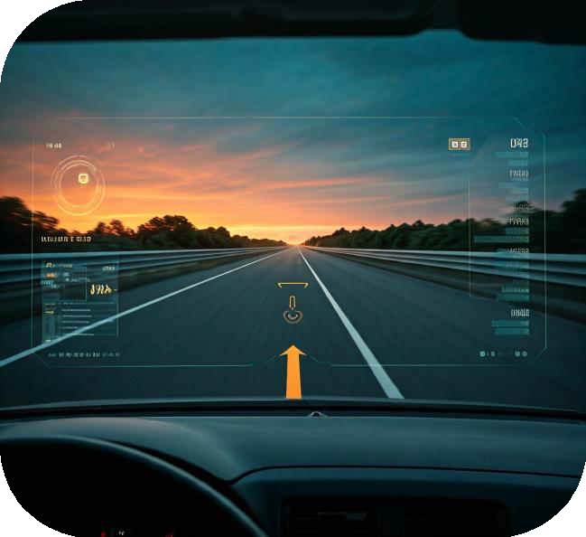
Innovations in AR technology
AR Glasses and Wearables: These devices overlay digital information onto the real world.
Enhanced Computer Vision: Object detection, tracking, and recognition capabilities in AR applications.
Haptic Feedback in AR: Enhances AR features with touch senses

Slide 34

Technologies & How they work in AR.
Visual-Inertial Odometry (VIO): This technique combines camera-based optical flow and IMU (Inertial Measurement Unit) data with AI techniques like deep neural networks to improve robotic movement precision in AR environments. By using Recurrent Neural Networks (RNNs) to analyze temporal motion patterns, it enhances real-time adjustments for robotic limbs or mobile AR systems.
SLAM for Dynamic Navigation: AI-optimized Simultaneous Localization and Mapping (SLAM) leverages Convolutional Neural Networks (CNNs) to extract features, creating robust environmental maps. Reinforcement learning (RL) is used to dynamically adjust navigation strategies, enabling AR-enhanced robots to adapt to shifting environments and obstacles without relying on pre-programmed maps.

Slide 35
Contd…
Depth Estimation Using CNNs: CNN-based depth estimation processes a single camera feed to infer the 3D layout of an environment. This enables robots to understand distances, avoid collisions, and perform tasks like grasping or manipulation in AR, where precise alignment of virtual and real objects is critical.

Slide 36
VR and AR in Action
Immersive Training and Education: VR in fields like aviation and surgery, while AR by overlaying interactive in real world.
Enhanced Remote Collaboration: VR enables virtual meetings with 3D environments, and AR offers remote assistance by laying guidance on physical tasks.
Consumer Experiences: VR allows for virtual shopping experiences, and AR provides virtual try-ons for products, making shopping more engaging and personalized while reducing return rates.

Slide 37
Future:
Unresolved issues and possibilities for future research.
~Yash Joshi

Slide 38
Current Challenges in HCI
There is also a need for more research on user privacy and data security in HCI systems.
These challenges require ongoing research and innovation to create more inclusive and secure technology.
We need to solve problems like making tech easier for people with disabilities, improving usability across different devices, and designing for all kinds of users.

Slide 39
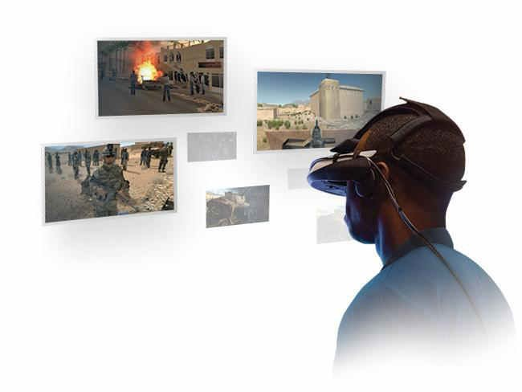
Emerging Trends in VR
Emerging trends in VR include the development of more realistic and immersive environments through improved graphics and haptic feedback.
Social VR experiences are gaining popularity, allowing
users to interact with others in virtual spaces.
Additionally, VR is being explored for therapeutic applications, such as treating PTSD and anxiety through controlled virtual environments.

Slide 40
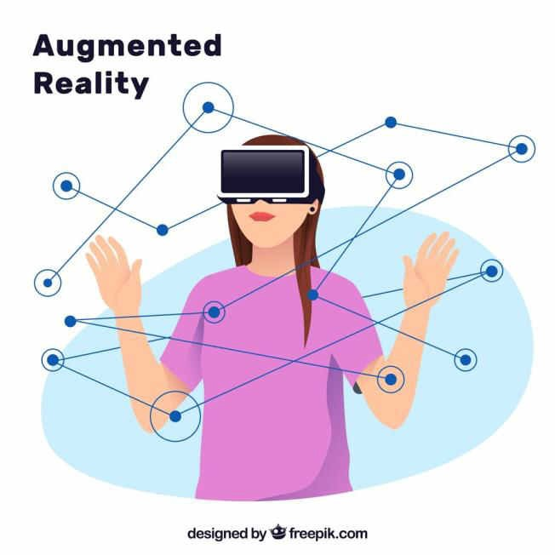
Future Research in AR
Future research in AR will focus on improving the accuracy and stability of digital overlays, developing new interaction methods, and integrating AR more seamlessly into daily life.
Research will also explore the ethical implications of AR, such as
privacy concerns and the impact on social interactions.
Advancements in AR technology will continue to shape how we interact with our environment.
40

Slide 41
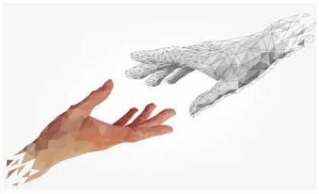
Integration of HCI, VR, and AR
The integration of HCI, VR, and AR is creating new possibilities for interactive experiences.
Combining intuitive HCI designs with immersive VR environments and context-aware AR applications leads to more seamless and engaging user experiences.
This convergence is driving innovation across various fields, from entertainment to education and beyond.

Slide 42
Ethical Considerations in Emerging Technologies
As HCI, VR, and AR technologies advance, ethical considerations become increasingly important.
Issues include ensuring user privacy, preventing misuse of technology, and addressing the digital divide.
It’s crucial to develop these technologies responsibly and inclusively, keeping in mind the potential
impact on society and individual well-being.

Slide 43
References
➔ Bowman, D. A., Kruijff, E., LaViola Jr, J. J., & Poupyrev, I. (2004). 3D user interfaces: theory and practice. Addison- Wesley.
➔ https://www.shutterstock.com/search/virtual-reality-transparent
➔ https://humancapitalleague.com/collaborative-modelling-in-ar-and-vr
➔ Azuma, R. T. (1997). A survey of augmented reality. Presence: Teleoperators & Virtual Environments, 6(4), 355- 385.
➔ Billinghurst, M., Clark, A., & Lee, G. (2015). A survey of augmented reality. Foundations and Trends® in Human– Computer Interaction, 8(2-3), 73-272.
➔ Milgram, P., & Kishino, F. (1994). A taxonomy of mixed reality visual displays. IEICE TRANSACTIONS on Information and Systems, 77(12), 1321-1329.

Slide 44
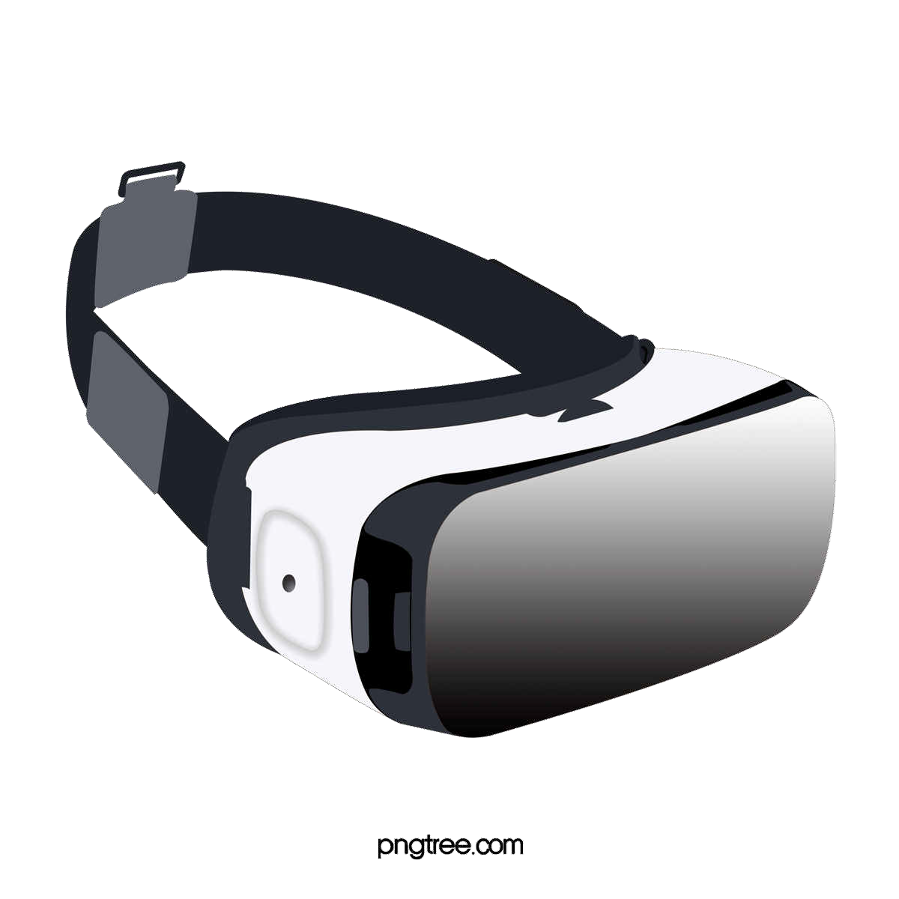
THANKS!
CREDITS : Priyanshu Nareda | 22114072
Sahil Kumar | 22114083
Shubham K. Verma | 22114092
Utkarsh Lohiya | 22114103
Yash Joshi | 22114108
Do you have any questions?
yash_j@cs.iitr.ac.in
+91 96919 25475

